Slide 1

Introducing Technical Architecture

Slide 2
Context
What is Operational or OLTP or Database Systems?
Limitations of OLTP Systems

Slide 3
Queries not answered by OLTP Systems
What are the three most popular areas in each city for the renting of property in 2004 and how does this compare with the figures for the previous two years?
What would be the effect on property sales in the different regions of Britain if legal costs went up by 3.5% and Government taxes went down by 1.5% for properties over £100,000?
Which type of property sells for prices above the average selling price for properties in the main cities of Great Britain?
What is the relationship between the total annual revenue generated by each branch office and the total number of sales staff assigned to each branch office?

Slide 4
Business Intelligent Systems
What is BIS?
BIS=Datawarehouse+Business Intelligence
Why BIS?
To take informed decisions at right time to grow business
Who are the users of BIS?
Managers

Slide 5
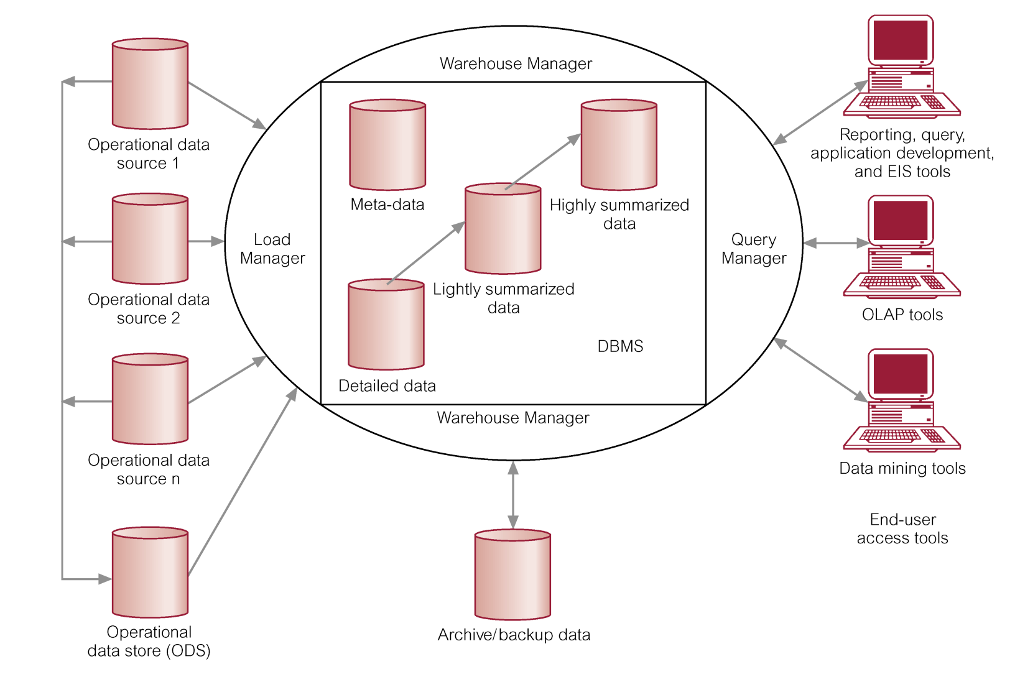
Typical Architecture of a Data Warehouse
© Pearson Education Limited 1995, 2005

Slide 6
Data Warehousing Concepts
A subject-oriented, integrated, time-variant, and non-volatile collection of data that support s management’s decision-making process (Inmon, 1993).
© Pearson Education Limited 1995, 2005

Slide 7
Subject-oriented Data
The warehouse is organized around the major subjects of the enterprise (e.g. customers, products, and sales) rather than the major application areas (e.g. customer invoicing, stock control, and product sales).
© Pearson Education Limited 1995, 2005

Slide 8
Integrated Data
The data warehouse integrates corporate application-oriented data from different source systems
The integrated data must be made consistent to present a unified view of the data to the users.
© Pearson Education Limited 1995, 2005

Slide 9
Time-variant Data
Data in the warehouse is only accurate and valid at some point in time or over some time interval.
© Pearson Education Limited 1995, 2005

Slide 10
Non-volatile Data
Data in the warehouse is not updated in real-time but is refreshed from operational systems on a regular basis.
© Pearson Education Limited 1995, 2005

Slide 11
Benefits of Data Warehousing
Potential high returns on investment
Competitive advantage
Increased productivity of corporate decision-makers
© Pearson Education Limited 1995, 2005

Slide 12
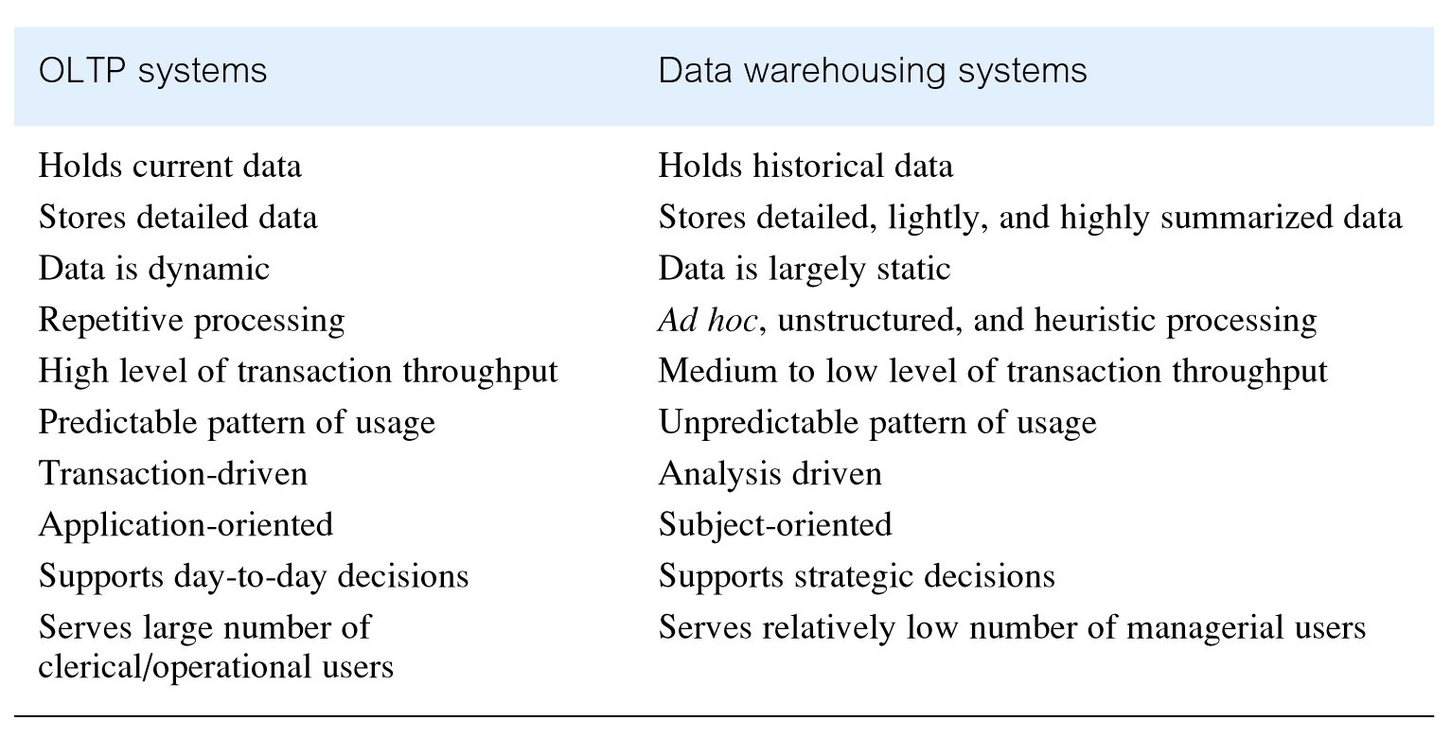
Comparison of OLTP Systems and Data Warehousing
© Pearson Education Limited 1995, 2005

Slide 13
Data Warehouse Queries
The types of queries that a data warehouse is expected to answer ranges from the relatively simple to the highly complex and is dependent on the type of end-user access tools used.
End-user access tools include:
  Reporting, query, and application development tools
  Executive information systems (EIS)
  OLAP tools
  Data mining tools
© Pearson Education Limited 1995, 2005

Slide 14
Problems of Data Warehousing
Underestimation of resources for data loading
Hidden problems with source systems
Required data not captured
Increased end-user demands
© Pearson Education Limited 1995, 2005

Slide 15
Problems of Data Warehousing
High demand for resources
Data ownership
High maintenance
Long duration projects
Complexity of integration
© Pearson Education Limited 1995, 2005

Slide 16
Components of BI Systems
Backroom
Presentation server
Front room

Slide 17
Some BI Tools
MS SQL Server 2012 SSIS,SSAS,SSRS
Oracle BI Standard Edition One
Pentaho
SAP BUSINESS INTELLIGENCE:
MS Power BI (Analysis and Reports) through couresra,EdX
Talend (ETL)
MicroStrategy (Analysis and Reports)
IBM Cognos Analytics (Analysis and Reports)
Google Data Cloud (Analysis and Reports)
Tableau (Analysis and Reports)

Slide 18
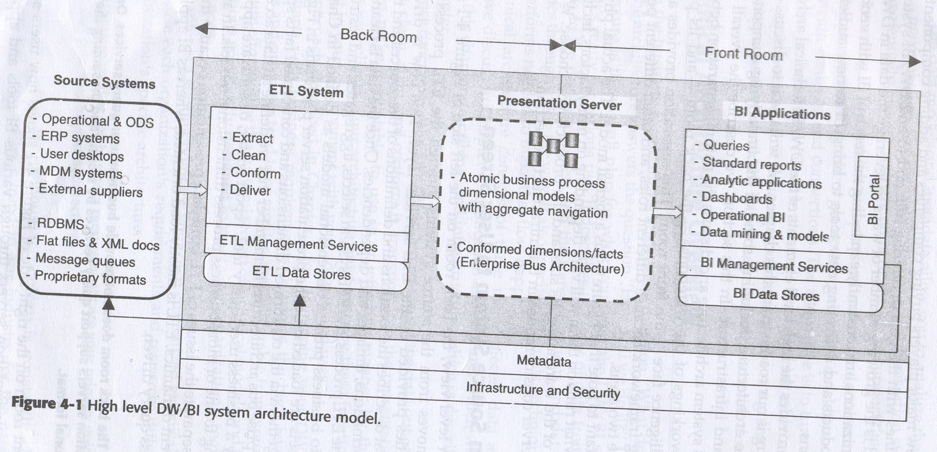
Technical Architecture Overview

Slide 19
Flow from Source System to user screen
Moves through ETL service layer
ETL selects, aggregates and restructures data into business process dimensional models
Loaded onto presentation server and tied via conformed dimensions and conformed facts

Slide 20
Common Architecture Features
Metadata driven
Technical metadata
Defines objects and processes
Tables, fields,datatypes,indexes
IN ETL sources, targets,transformations and frequency

Slide 21
Business Metadata
What data you have?
Where it comes from?
Display name and content description fields are basic Examples Business metadata

Slide 22
Process Metadata
Results of various operation in warehouse
In ETL process start time ,end time, disk reads, disk writes
Used to monitor user access and popularity of Data Warehouse

Slide 23
Flexible service layers
SOA
Service interface definations
Quality of service characteristics
Repositories for business policies
Governance of services
Lifecycle management

Slide 24
Back Room Architecture
General ETL Requirements
Productivity Support
-needs to provide basic development environmental capabilities like code library management checkin/out,version control production and development system builds
Usability
-must be usable.

Slide 25
-employs GUI to define and ETL task
-system documentation
Metadata Driven
-ETL process must be meta data driven.
Build vs Buy

Slide 26
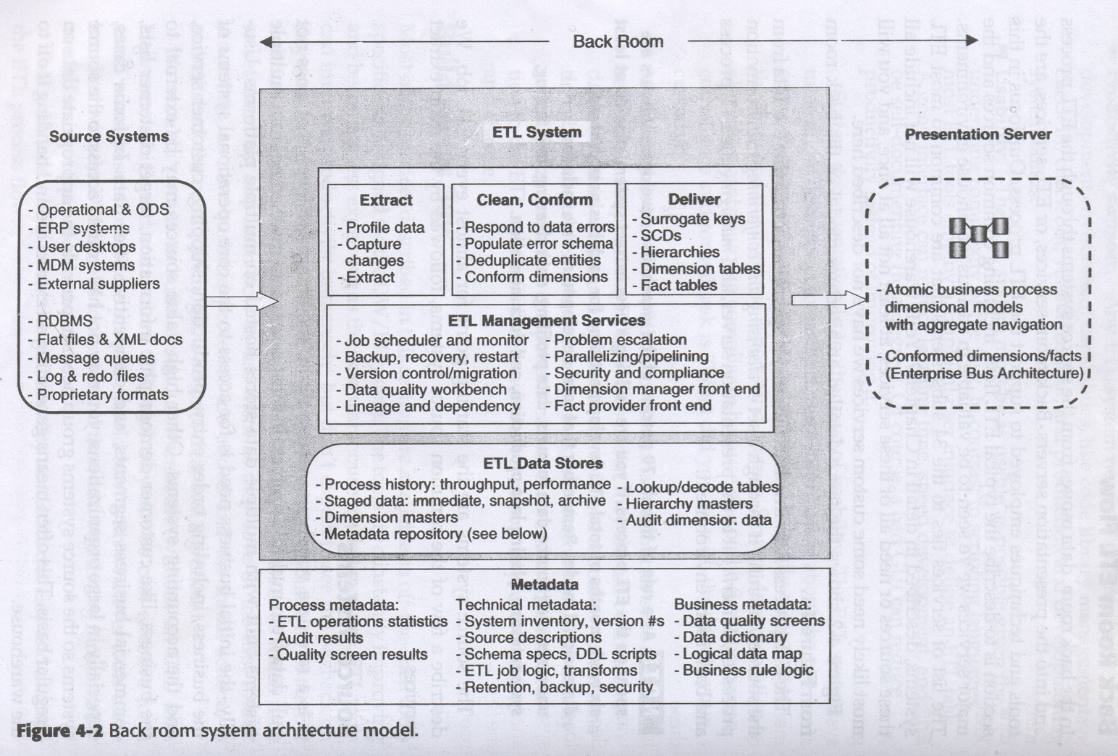
Back Room ETL Flow

Slide 27
Source systems
-ERP Systems
-operational data stores
--Xml files
-message queues, log files
-proprietary formats

Slide 28
Extract
Data profiling
Change data capture
Extract system

Slide 29
Clean and conform
Data cleansing
Error event handling
Audit dimension creation
Deduplicating
Conforming

Slide 30
ETL Management Services
Job scheduler
Backup system
Recovery and restart
Version control
Workflow migration
Workflow monitor
Sorting
Lineage and dependency

Slide 31
Additional Backroom Services and Trends
Data service providers
Functional service providers
Data Delivery Services
ETL data stores
ETL System Data Stores
Data Quality Data stores

Slide 32
ETL Metadata
Process Metadata
-ETL operations statistics
-Audit results
-Quality screen results

Slide 33
Technical Metadata
-System inventory including version numbers
-source descriptions
-source access methods
-ETL data store specifications and DDL scripts
ETL data store policies and procedures
ETL job logic, extract and transforms
Exception handling logic

Slide 34
Business Metadata
Data quality screen specifications
Data dictionary
Business rule logic

Slide 35
Presentation Server Architecture
Business requirements for information
-Access to data from all major business processes
-Access to both summary and atomic data
-Single source for analytical data

Slide 36
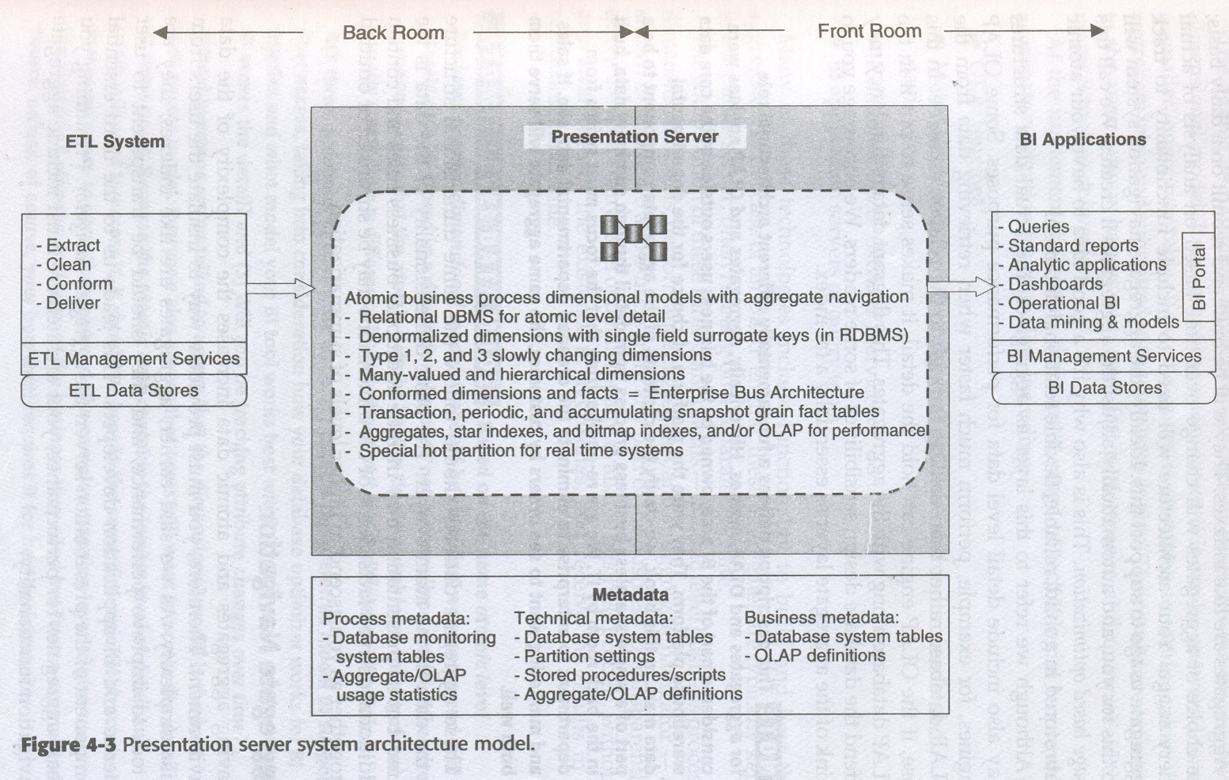

Slide 37
Detail Atomic Data
-analytic queries require detail or summary data
-atomic data are built with conformed dimensions as per enterprise bus matrix
-stored in rdbms than in OLAP

Slide 38
Aggregates
-organizations have large data sets
-summary query takes long time
-pre-aggregating data during load process
-choice of aggregates changes based on analysis of actual query usage
-usage based optimization

Slide 39
Aggregate Navigation
-aggregate like indexes improves performance
-include aggregate navigation facility
-input from user query
-see if query can be answered using smaller aggregate table
-so query is rewritten to work against aggregate table and submitted to database engine

Slide 40
Technologies providing aggregate navigation facilities
OLAP engines
Materialized views
ROLAP services
BI application servers or query tools

Slide 41
Design Disciplines within presentation server
Contents of PS includes
-Denormalized Dimension tables with single field surrogate keys
-Type 1,2,3 slowly changing dimensions
-many valued and hierarchical dimensions
-conformed dimensions and facts based on enterprise bus architecture
-transaction, periodic snapshots and accumulating snapshots fact tables

Slide 42
Adjusting PS architecture
Includes partitioning warehouse onto multiple servers either vertically or horizontally
VP is component based partitioning
Server for atomic level, aggregates and server for aggregate management and navigation
Separate servers for background ETL processing

Slide 43
Horizontal Partitioning
Load distribution based on data sets
Separate presentation servers for specific business process dimensional models

Slide 44
Presentation Server Metadata
Process metadata
-Database monitoring system tables
information about use of tables throughout presentation server
-aggregate usage statistics including OLAP usage

Slide 45
Technical Metadata
-Database system tables
-partition settings
-stored procedures and SQL scripts
-aggregate definitions such as Mviews
-OLAP system definitions specific to OLAP databases
-Target data policies and procedures
retention,backup,archive,recovery,ownership

Slide 46
Business metadata
Provided by BI applications
OLAP definitions

Slide 47
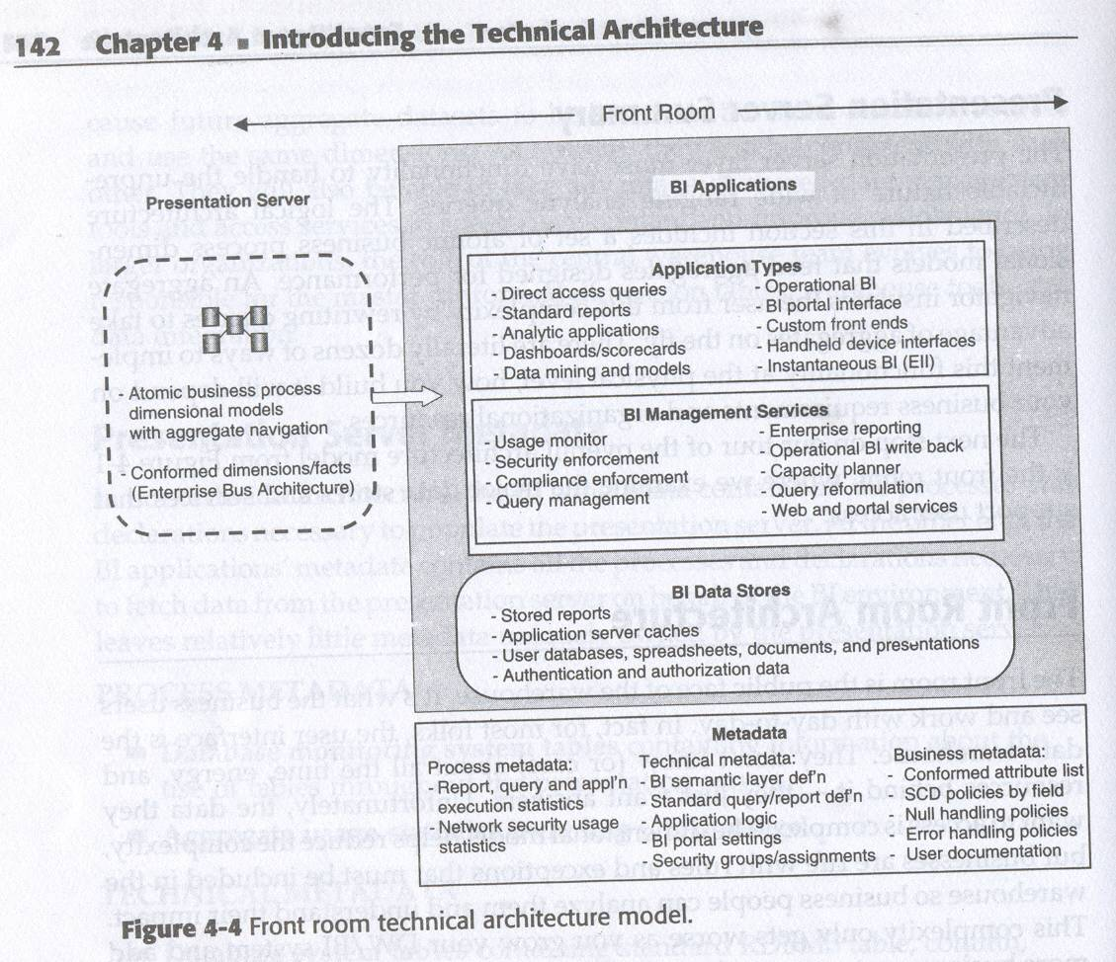
Front Room Architecture

Slide 48
BI Application types
Direct access queries
-desktop query tools applications
Standard reports
-regularly scheduled reports typically delivered via BI portal
Analytic applications
-budgeting, forecasting and business activity monitoring

Slide 49
Dashboards and scorecards
Datamining and models
Operational BI-Realtime queries are handled

Slide 50
Application Interfaces
BI portals
Handheld device interface
Instantaneous BI-Realtime integrated DW from source to target

Slide 51
BI Management services
Shared services
-metadata, security, usage monitoring, query management, enterprise reporting

Slide 52
Metadata services
Security services
Usage monitoring
-performance-usage information to tune performance
-user support-poorly formed queries and constructing more efficient queries

Slide 53
Marketing-publish usage statistics to inform management
Planning-Analyze usage , av.query time etc
Compliance-audit trail of all user activity

Slide 54
Query Management
Query reformulation
Query retargeting and drill across
Aggregate navigation-query can be satisfied by an available aggregate table than summing up detail records
Query governing and prioritization
-limits on num of queries/sec
-time required to execute query in sec based on query plan

Slide 55
Enterprise Reporting Services
Report development environment
Flexible report definitions
-compound document layout dashboards with graphs and tables on same page. Formatting control for display and print
Report Execution Server
-central resource for running and staging for delivery
Parameter or variable driven capabilities
-change region name parameter and get entire set of reports
Time & Event based scheduling of report execution
-run at time or event such as completion of ETL process

Slide 56
Iterative execution or separation of results
-create a copy of report for each region
-report file mailed to region manager
Flexible report delivery
-via multiple delivery methods like email, web, network directory. In multiple result types like file,html,pdf,excel
User accessible publish and subscribe capabilities
-make report available to departments
-Subscribe to reports others have made

Slide 57
Report linking
-click and display department wise report
Report library with browsing capability
-user interface allows the user to search reprt library using different criteria
Mass distribution
-mass distribution and viewing by users across organization and customers via internet
Report Env admin tools
User access security
-authenticate users and check access rights of users

Slide 58
Web Access
Web based data access services
Direct access to specific information
Monthly summaries of purchases, sliced in various ways

Slide 59
BI Data Stores
Stored reports
-reports stored at client side cache to improve performance
-faster response to request of previously retrieved result set
Application server caches
-data oriented services for operational BI, analytic applications and enterprise reporting have their own data stores
Local user databases
Disposable analytic data stores
Results from analytic applications

Slide 60
Downstream systems
-other systems using facilities of DW/BI
-Budgeting systems using data from warehouse
-Like monthly phone bills for last three years
-Forecasting systems using historical data
-CRMs using DW/BI data
-Need to support such downstream systems
Data Store Security
-authentication and authorization of data stores

Slide 61
BI Meta Data
Process Metadata
-report and query execution statistics
-Network security usage statistics
Technical metadata
-BI semantic layer definitions-business names for tables, columns mapped to presentation server objects
-standard query and report definitions
-application logic
-BI portal settings

Slide 62
Business Meta data
-Conformed attribute and fact definitions and business rules
-User docs and training materials

Slide 63
Infrastructure
Infrastructure Drivers-bus req, expertise, policy, growth rates, ETL splits
Backroom and presentation server infrastructure factors
-Data size
-Volatility
measures dynamic nature of DB.
Business and technology changes must be considered
impact size and speed of H/W platform
-Number of users-active concurrently, peak load
-Number of business processes
-Nature of use-front end tools, report scheduling, data mining load

Slide 64
Service level agreements
-Performance and availability requirements affect size and quantity of hardware needed.
-24x7 user support
-centralized operational systems and warehouse
-if decentralized operational systems then decentralized presentation server

Slide 65
Technical readiness
-technical expert manpower in H/W ,OS, Database, Datawarehouse, BI level at setup, management, security, backup and recovery level
Software availability
-requirements analysis indicates need for certain capability
Financial resources
-amount of money spent on project is usually a function of projects expected value.
-better understanding of business requirements and target DW/BI is required

Slide 66
Parallel Processing Hardware Architectures
Symmetric multiprocessing(smp)
Massively parallel processing(mpp)
Non-Uniform memory Architecture(NUMA)
Clusters
-scaleout
-scaleup
-Shared cache
-Federated data
-Replicated data

Slide 67
Partitioning Hardware
-16 proc, 4 ETL, 8 rdbms,4 reporting
Considerations common to all parallel architectures
-software availability, system admin complexities, type and version of os
-utilities and drivers available for os
-run on current version of rdbms, ETL tool, development environment, datawarehouse utilities and application servers

Slide 68
Hardware Performance Boosters
Disk Issues
-disk drives
-DW require high bandwidth of IO subsystem than OLTP
-high end drives require disk subsystem called SAN
-RAID
-Fault tolerance
-Back up
-Expensive but good value over time

Slide 69
Memory
-more is better
-BI queries are much larger and require several passes through large tables
-If table in memory performance improve
-Go for 64 bit os, databases than 32 bit
CPUS
-more and faster is better
-Dual core and quad core
Secondary storage
-configuration includes resources to support backup and archiving
-disk to disk backup

Slide 70
Database Platform Factors
Major database vendors provides support for DW/BI
Rest through high end data warehouse appliance
Aggregate management and navigation

Slide 71
Characteristics of Relational Engines
-add capabilities like dimensional model support, star join optimization, bit mapped indexes, data compression and improved cost based optimizations,
Characteristics of OLAP engines
-designed to support analysis
Serve two purposes 1) pre-aggregating 2)complex analysis through more analytically oriented query language
All database vendors support some OLAP queries

Slide 72
Front Room Infrastructure factors
Application server
-memory, Disk, platform sharing,bottlenecks
Desktop considerations
-cross platform support-mac,sun
-desktop os and software-os version, browser version
-memory

Slide 73
Connectivity and Networking factors
Band width-large block transfers from source to presentation servers
Remote access
File transfer-ssl
Database connectivity-multiple drivers support
Directory services-x500,LDAP,user directories, PCs in network,printers or any lookup

Slide 74
MetaData
Value of Metadata integration
Impact analysis
Audit and documentation
-lineage analysis
-understanding contents and source of table, column
-lineage analysis use audit metadata to determine origin of fact or dimension row
Metadata quality and management
-multiple copies on diff systems get out of sync
-DW/BI developer should know this ahead of time
-less problematic in business meta data
-provide common extra field for description

Slide 75
Option for metadata integration
-DW/BI involves products from different vendors
-need for standards
-common warehouse metamodel(CWM) with XMI
-XMI is xml based metadata interchange standard
-MetaObject facility (MOF)is underlying storage facility for CWM
-single source DW/BI system vendors-many vendors provide all tools with common metadata management and their tools share central metadata repository
-core vendor support-offer metadata management systems

